Slide 1
Final Project: Machine Learning
Monuments of the world image classification

Slide 2
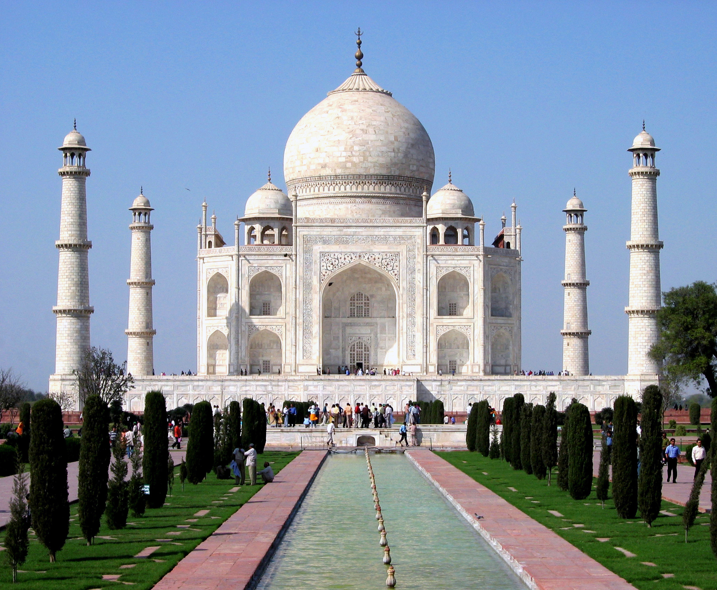
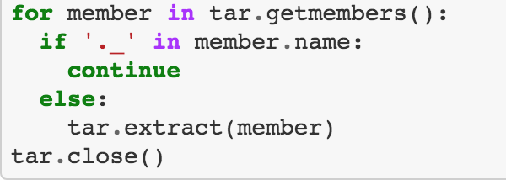
Web Image Scraping
Used python library to scrape Google Images for 10 pre-selected monuments
Scraped 50 for each monument to train our model; 10 to test
Cleaned data by renaming files and removing corrupted data

Slide 3
include_top=False Training the model
Built stitch model using Colab, Keras, VGG model, and Sci-Kit learn, Tensorflow (and a lot of time)
Stitch removes prediction layers and allows us to train our own weights
Transfer Model uses unreliable classification layers (used for classifying common objects) that impacted model’s accuracy
Train with fewer pretrained parameters to help improve accuracy

Slide 4
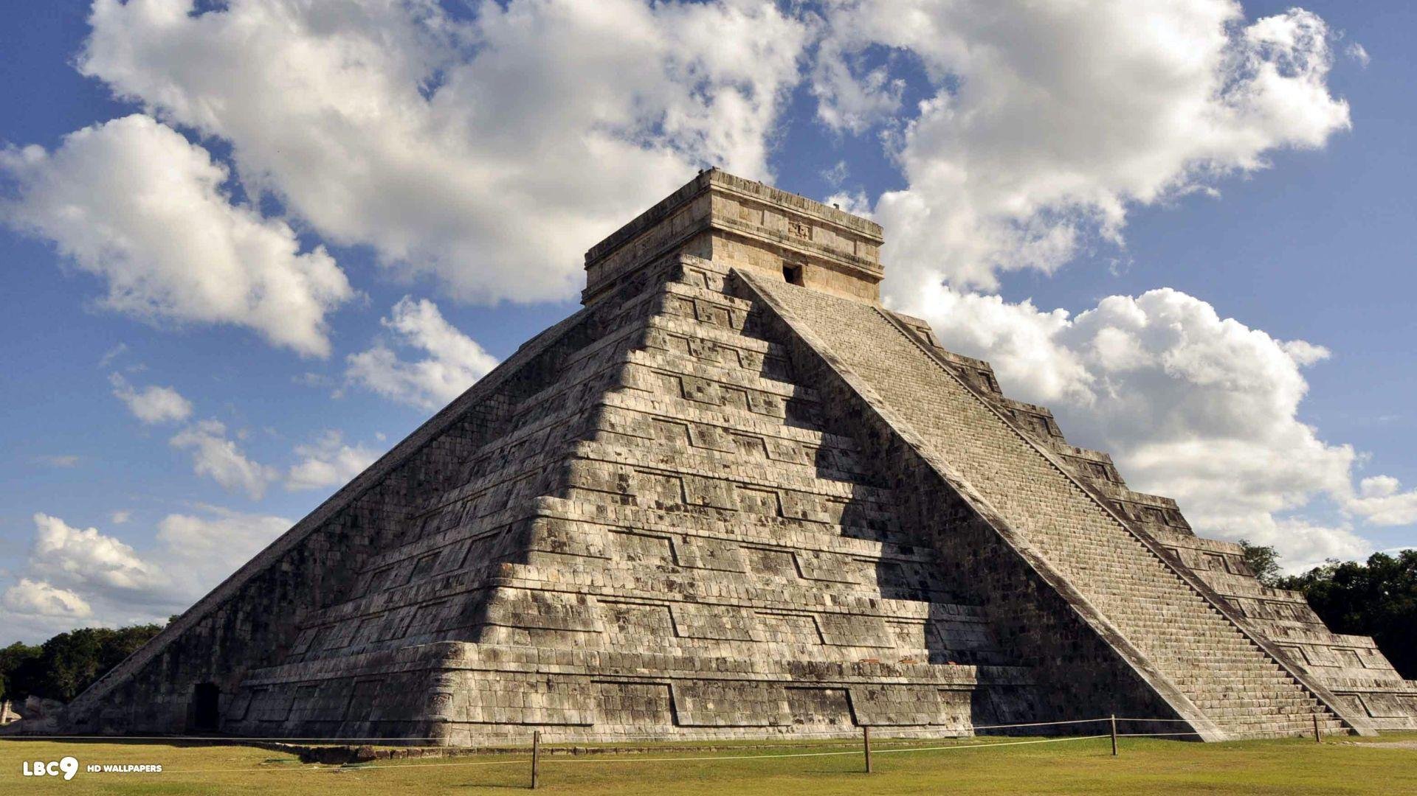
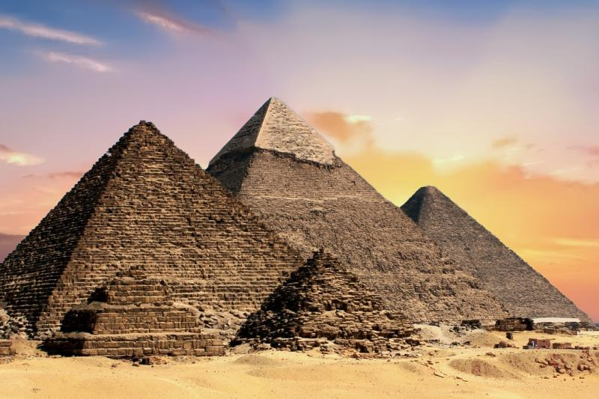

Feature model Vs stitch Model Received 93+% accuracy!!!
Chichen Itza
Pyramids of Giza

Slide 5
Image classification Analysis

Slide 6
Potential improvements
Adding more images would likely increase the accuracy (more training)
Run more epochs to increase training cycles - could affect model accuracy?
Improving the user interface i.e. monument related content, images, maps (Google API) and other travel related data

